Slide 1

The room for controlling your development

Slide 2
What is i18n and why it matters:
i18n (internationalization) — the process of engineering your app so it can be adapted for any language or region, without changing its core code. The "18" refers to the 18 letters between the I and N in "internationalization".
L10n (localization) — the act of actually adapting your app for a specific locale: translating strings, formatting dates, switching currency symbols. You can't do L10n without i18n first.
Locale — a string combining a language code (ISO 639) and an optional territory (ISO 3166). Examples: en_US, fr_FR, ar_EG, de_DE.
Imagine you're building an e-commerce platform. You launch in the US, it works great, and you decide to expand to Germany and Saudi Arabia.

Slide 3
What actually changes per locale:
Translation is just the beginning. Here is everything that silently breaks when you ignore locale:
Dates become ambiguous. 04/05/2026 means April 5th to a US user and 4th of May to a German user. Your order confirmation emails now tell the wrong delivery date — and nobody notices until complaints arrive.
Numbers lose meaning. In the US, 1,000.50 is one thousand and fifty cents. In Germany, that same string means 1.0 — the comma is the decimal separator there. A raw Python float in your template will show garbled prices.
Currency placement is wrong. US: $49.99. France: 49,99 € — symbol after the number, comma as decimal. A hardcoded "$" + price breaks both rules simultaneously.
Compliance risk. In some jurisdictions, displaying a price without the correct local currency format or tax inclusion is a legal issue, not just a UX one.
RTL layout collapses. Arabic and Hebrew read right-to-left. Without dir="rtl" and RTL-aware CSS, your Saudi users get navigation, buttons, and text blocks all mirrored incorrectly — not just ugly, but unusable.

Slide 4
Installing and configuring flask-babel:
pip install flask-babel
For more complex applications, you might want to have multiple applications for different users, which is where selector functions come in handy.
The first time the babel extension needs the locale (locale code/ID) of the current user, it will call a localeselector() function, and the first time the time zone is needed, it will call a timezoneselector() function.
If any of these methods return None, the extension will automatically fall back to what’s in the config.

Slide 5
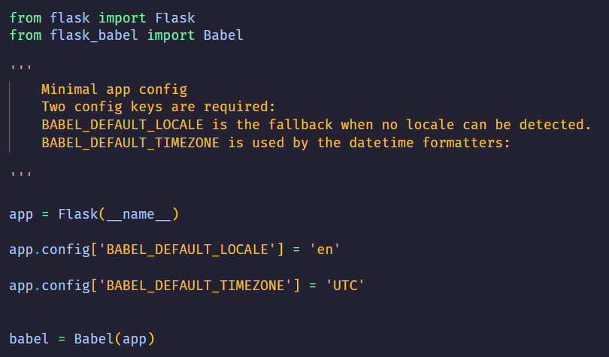
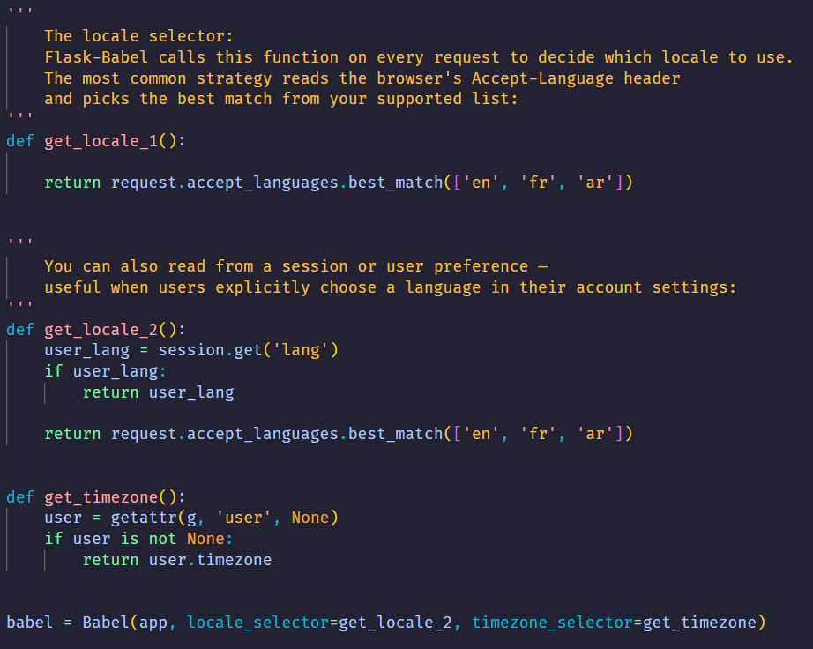
Installing and configuring flask-babel:

Slide 6

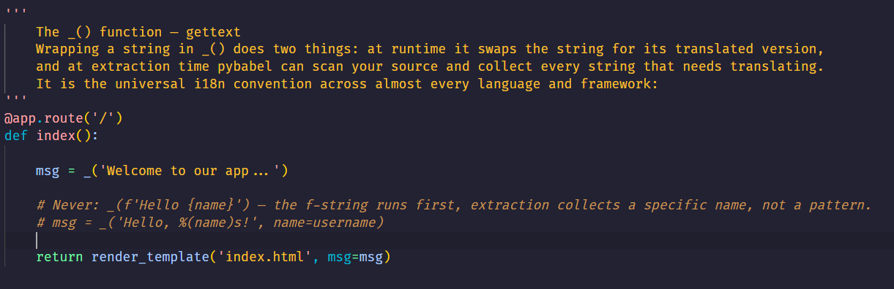
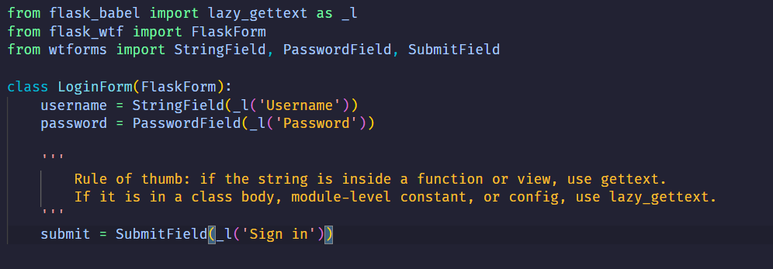
Marking Strings for translating:
gettext runs immediately. If you call it at module load time (e.g., inside a class body for a form field label), there is no active request yet and no locale is set — it will always return the default language. lazy_gettext defers the translation until the string is actually rendered, when a request context exists:

Slide 7
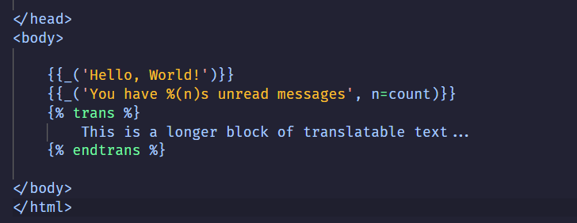


Marking Strings for translating [JINJA]:
Flask-Babel injects _() into the Jinja2 global namespace automatically — no import needed in templates:
The {% trans %} block tag is useful for longer strings that contain HTML — it avoids awkward _() calls with embedded markup

Slide 8
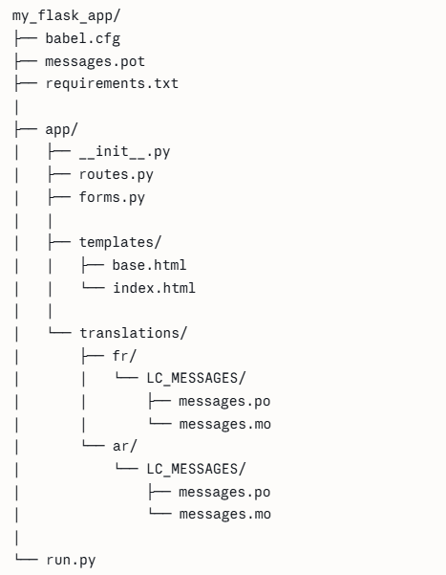
The translation workflow (pybabel):
Every step produces a file that feeds into the next. The most common confusion is running the wrong command when adding new strings
.py / .html
extract
.pot
init / update
.po
translate
compile
.mo
PROJECT STRUCTURE

Slide 9

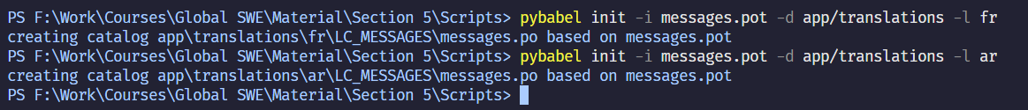
The translation workflow (pybabel):s
1. babel.cfg — tell pybabel where to look
Create this file at your project root. It maps file patterns to parsers so pybabel knows how to extract strings from Python files vs Jinja2 templates:
2. Extract — scan source files
Reads all files matching babel.cfg, finds every _() and _l() call, and writes them to a .pot file (a template — no translations yet, just a list of all translatable strings):
3. Init — create a new language
Run this once per language. It creates the directory structure and a .po file populated with all the strings from .pot. The .po file is what translators edit:

Slide 10
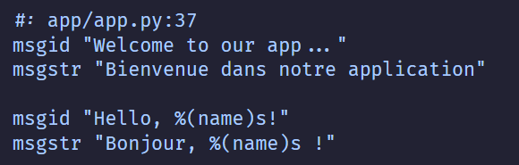
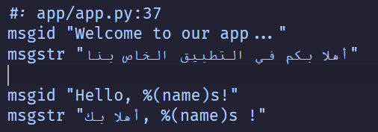

The translation workflow (pybabel):
4. Translate — edit the .po file
Open app/translations/fr/LC_MESSAGES/messages.po. Each entry has a msgid (the original string) and an empty msgstr to fill in:
5. Compile — generate the binary .mo
Flask-Babel does not read .po files at runtime — it reads compiled .mo (machine object) files. You must recompile after every edit to the .po file:
Run this when you update the translation files

Slide 11
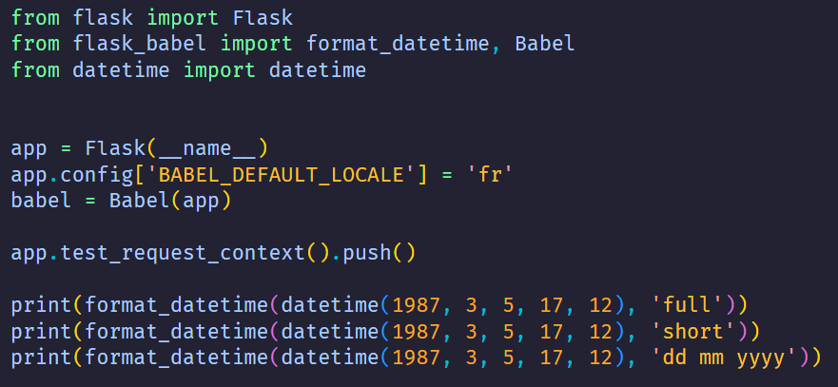
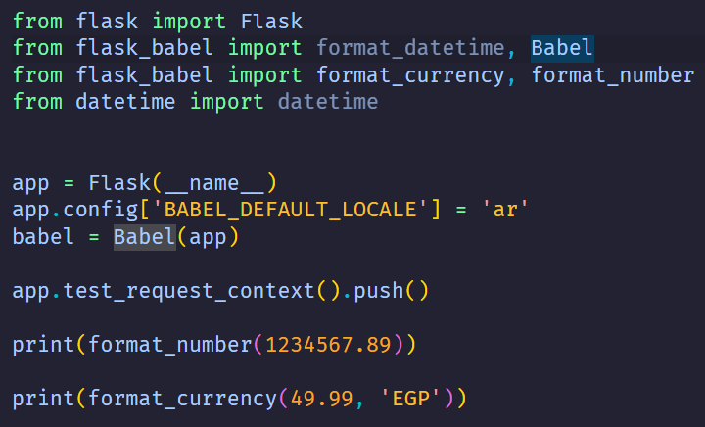
Dates, Numbers, and Currencies:
Flask-Babel's formatting functions solve all of this by reading the active locale and applying the correct convention automatically — no translation file needed.
Once you change the locale, the formatting changes directly

Slide 12
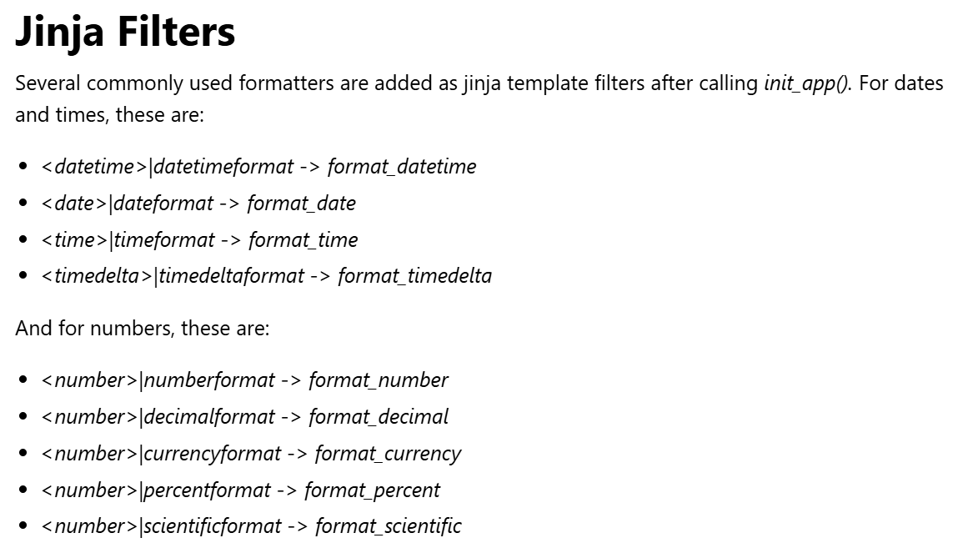
Dates, Numbers, and Currencies:

Slide 13
References:
https://python-babel.github.io/flask-babel/
https://www.youtube.com/watch?v=8Drid-ReNeg&t=168s
Record: https://drive.google.com/file/d/1wZupgifRIk-i-SeBLWk3mf6b4Q6JevHk/view?usp=sharing

